Slide 1



BOOK TALK: All WE HAVE LEFT Written By: wendy mills
Kendralyn Burr

Slide 2
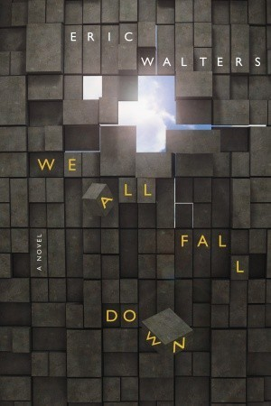
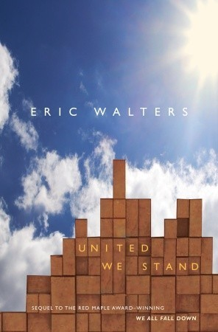
Jesse (2016):
She begins to describe her day in the tower, starting so innocently as she sat at her desk checking e-mails and eating yogurt, and then, bam, out of nowhere, everything changed. One plane hit, then another, and then the towers began to fall.
The towers were only half-full. A lot of people weren’t at work yet, and the horde of tourists hadn’t arrived to visit the observation deck on the top of the south tower, or the restaurant at the top of the north one. It could have been so much worse. Anne Jonna made it out, so did approximately twelve thousand other people. But my brother was not one of them.
(Kindle edition pg. 177-178)
Alia (2001):
The building trembles, and a great cloud explodes toward us, dark and boiling. “Get down,” Travis yells. “Get down!” He pushes me to the floor and draws my face into his chest as the smoke engulfs us. Every breath hurts, and I close my eyes and pray as hard as I ever have in my life.
The other tower fell, it fell straight down like a waterfall of concrete and steel, and, oh God, please help me, because is this one going to fall too?
(Kindle edition page 321)

